Slide 1
GLOBAL ECONOMY 2022 TEAM 4
Darren Littlejohn
Lucas Campos
Tania Amaral
Temitope Oniyide

Slide 2
The Problem Context
Inflation is a crucial economic variable that affects the living standards of individuals and the overall health of the economy. High or unpredictable inflation can erode the purchasing power of consumers and lead to economic instability" (Blanchard & Gali, 2007).
Analyzing core inflation can help policymakers and economists better understand underlying inflation trends that are less influenced by short-term price fluctuations in these volatile categories (Benati, 2005).
COVID-19 has significantly impacted economies worldwide. The dataset comprises observations on inflation and cost of living indexes across various countries in 2022

Slide 3

PROJECT INTRODUCTION
Objective: Explore relationships and patterns among economic and demographic variables across countries in 2022.
Understand interdependencies among inflation rates, cost index, population size, and other economic/demographic factors.
Identification of common factors influencing inflation rates or variations across countries.
Understanding how cost index affects a country's economic dynamics.
Grouping countries based on similarities or dissimilarities in economic and demographic profiles.

Slide 4
Data Description
Data type: Categorical data and Numerical data
The dataset consists of 117 rows (observations) and 13 columns (variables).
Different variables including four inflation indicators alongside population and cost of living indexes.

Slide 5
DATA CLEANING

Slide 6
Data Cleaning Process
Handling Missing values
- Identify missing values across columns and rows: 62 total
- Approach to fill the missing values: Median Insertion
Duplicate values
- Identify and remove duplicate entries: None
Standardizing Data
- Check inconsistencies in data( direction or unit): Converting to z-score
Outliers Detection
- Visualization techniques to identify outliers : Scatter plot matrix, Boxplot,
- Assess outliers based on visual representation and remove them

Slide 7
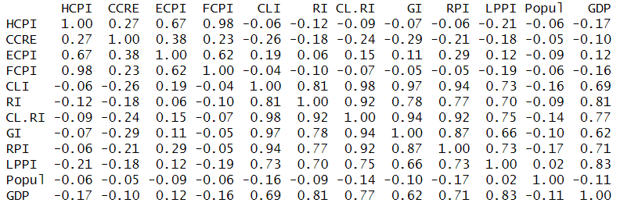
Correlation Matrix

Slide 8
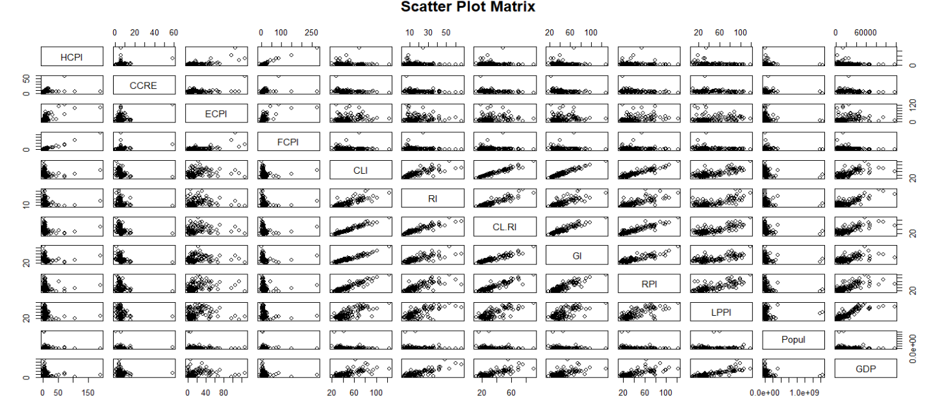

Slide 9
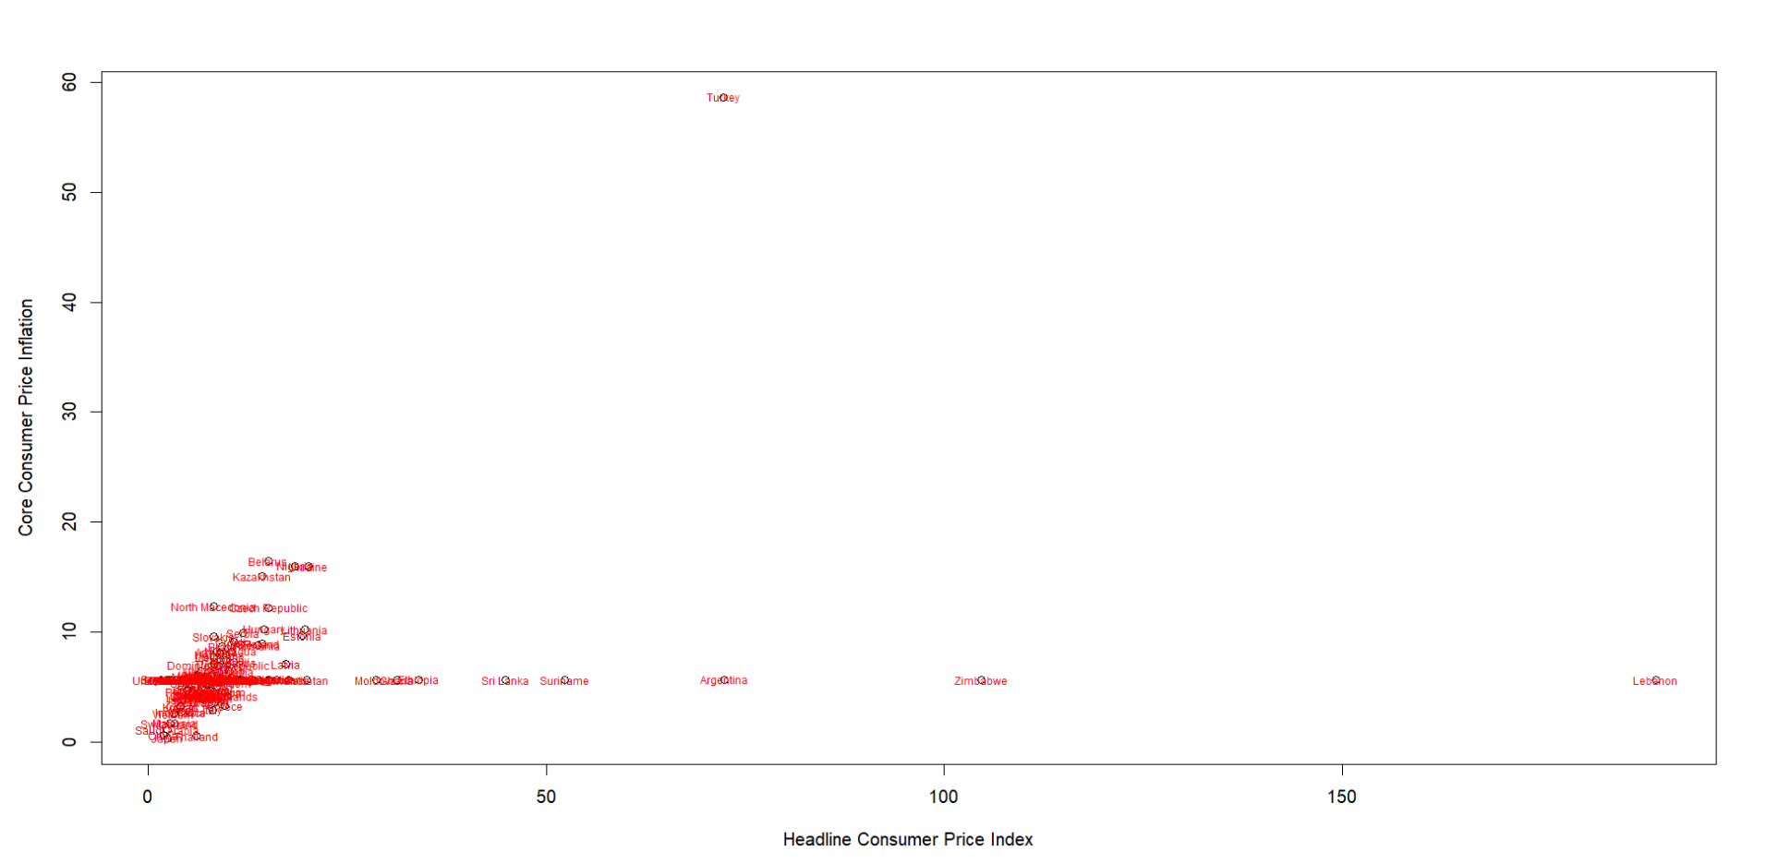
Detecting outliers by Scatterplot

Slide 10
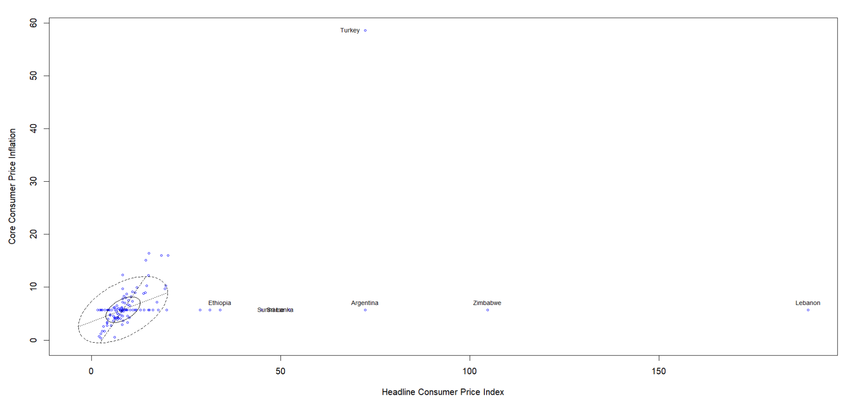
Detecting outliers by Bivariate Boxplot

Slide 11
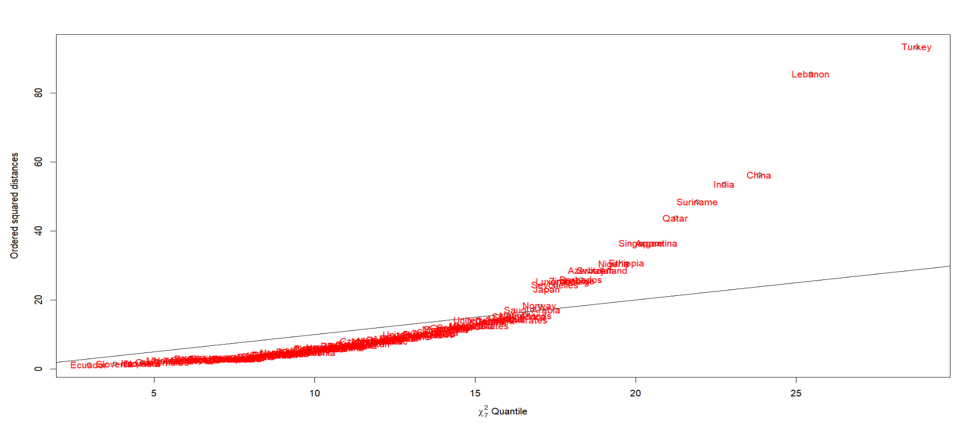
Chi-sq plot for Mahalanobis distances

Slide 12

Output
Outliers :
Turkey
Lebanon
Zimbabwe
Argentina
Sri Lanka
Suriname
Ethiopia
Correlation between two variables: HCPI and CCRE
Before removing outliers: 0.27
After removing outliers: 1

Slide 13
DIMENSION REDUCTION ANALYSIS

Slide 14
Principal Component Analysis
What: Principal Component Analysis for Dimension Reduction Analysis.
How: Using R and the; princomp() function,
4 components accounted for about 88% (over 75%) of the variance.

Slide 15
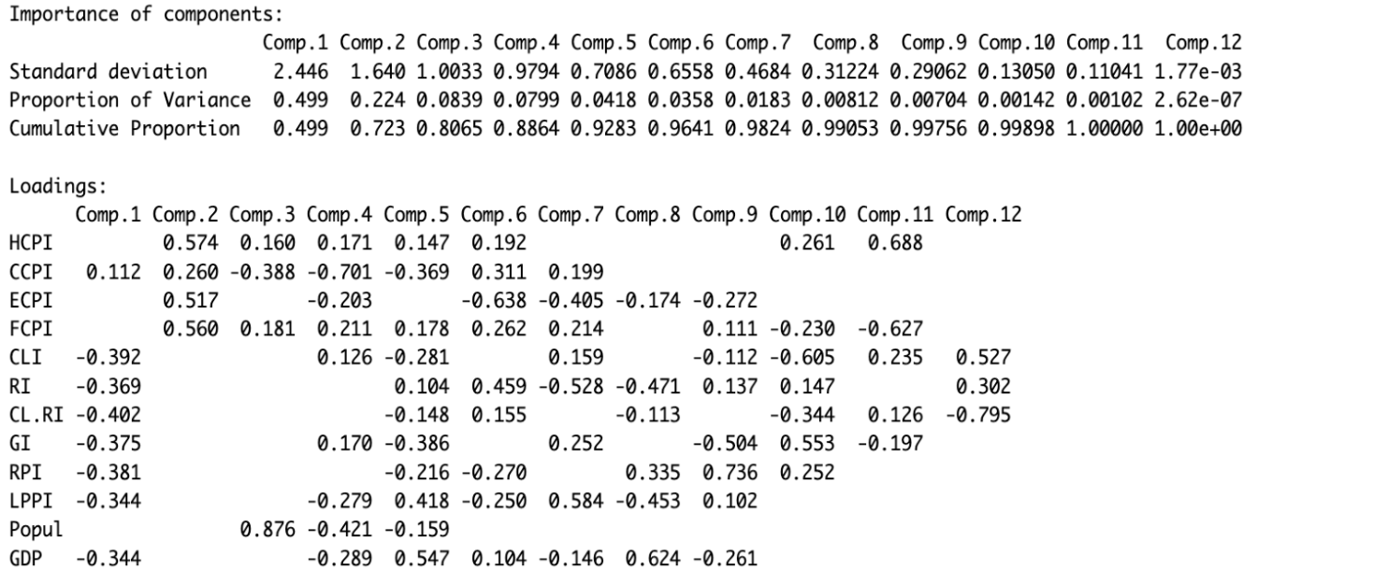
Principal Component Analysis
The team used Principal Component Analysis as our dimension reduction technique

Slide 16
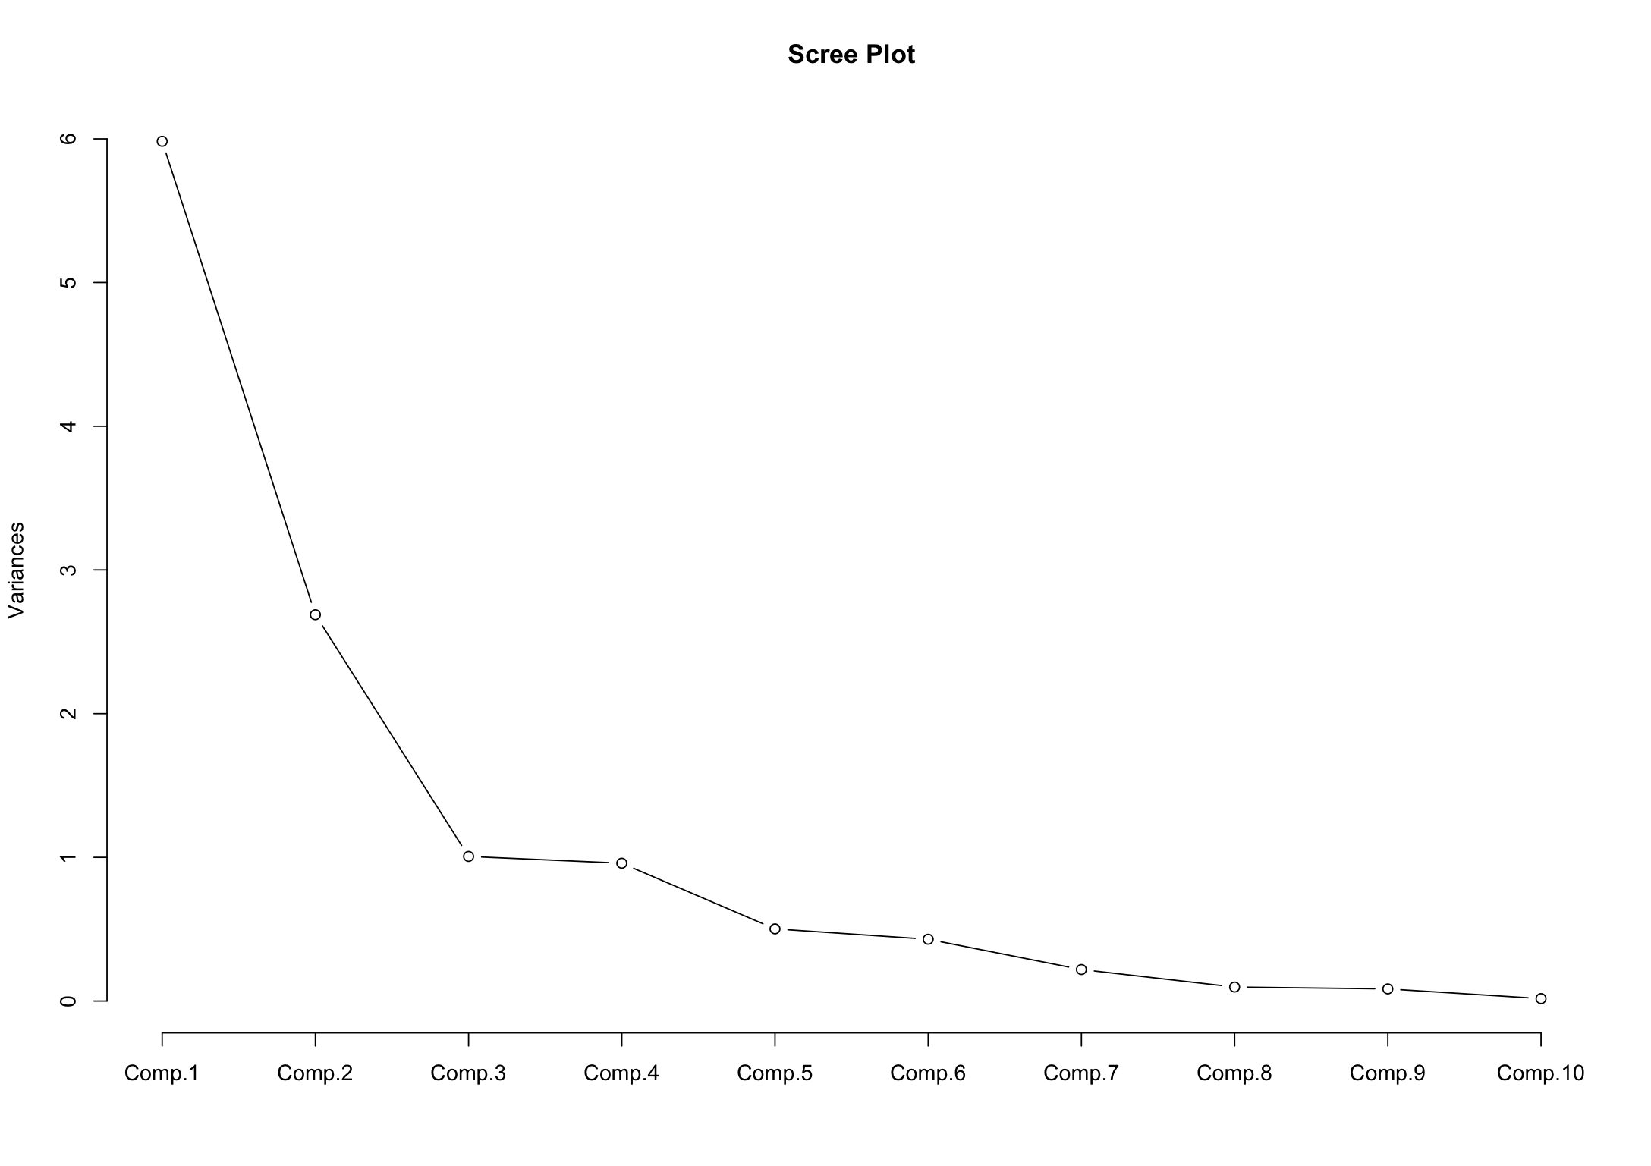
Scree Plot

Slide 17
Canonical Analysis
Was Cost-of-Living influenced by Inflation?
We divide the variables into two sets, one focusing on inflation indicators(X):
(HCPI), (CCPI), (ECPI), (FCPI)
and the other on cost-of-living indicators(Y):
(CLI), (RI), (CL.RI), (GI), (RPI)
Correlation between canonical pairs:
Cor(U1, V1) = 0.658

Slide 18
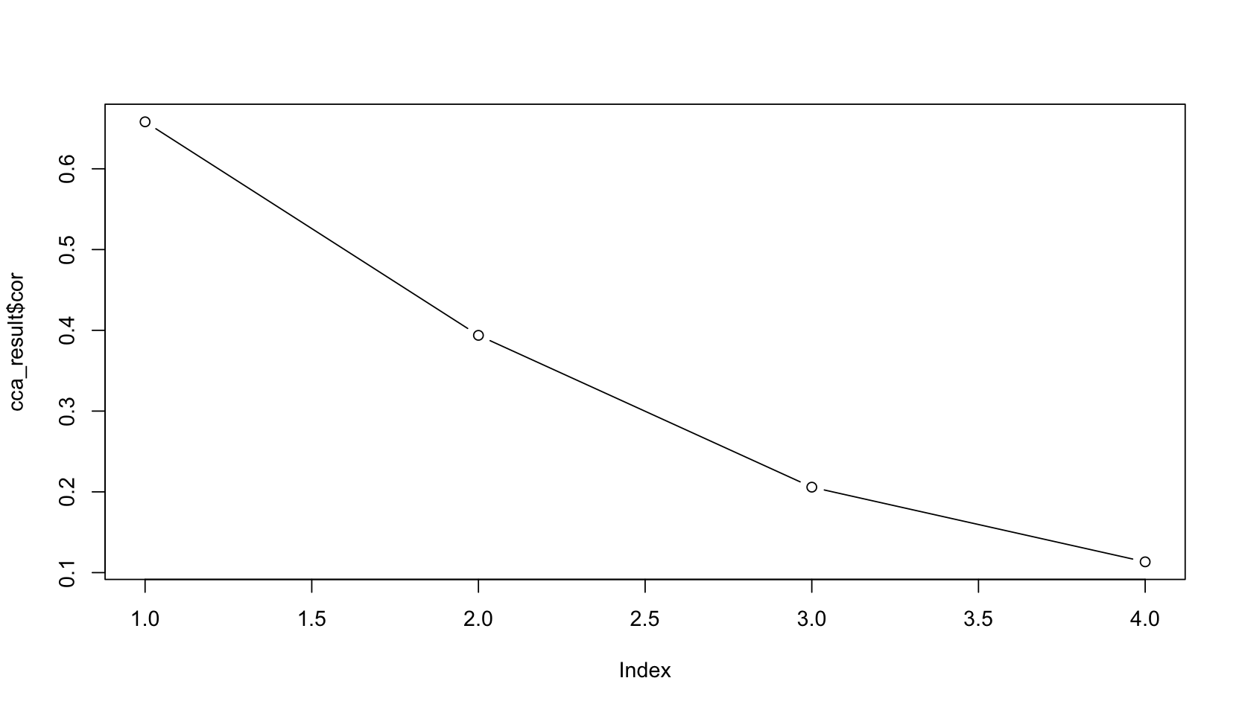
Correlation Between Canonical Pairs

Slide 19
CLUSTER ANALYSIS

Slide 20

What: Cluster Analysis is a wide range of numerical methods which are used discover groups of observations
How: Group dissimilar observations into separate groups (countries with similar inflation metrics)
Why: Find patterns, meaning, insights, and meaning in data

Slide 21

Methods: Three clustering methods:
Hierarchical Clustering: Each data point is initially treated as a single cluster.
Builds a hierarchy of clusters into a tree (dendrogram of inflation metrics)
K-Means Clustering: Cluster centroids randomly from the data points. Good for large data sets. Algorithm aims to minimize the within-group sum of squares (WGSS.)
Visualizations are Scree Plot to find number of country clusters and PCA Biplot to see what countries belong in clusters and how they are related to two principal components
Model-based: Each cluster corresponds to a different statistical distribution. Fitting is slow on large data sets. BIC (Bayes Info. Criteria)
Analysis/Uncertainty: Interpret results on Global Inflation, uncertainty reported.

Slide 22
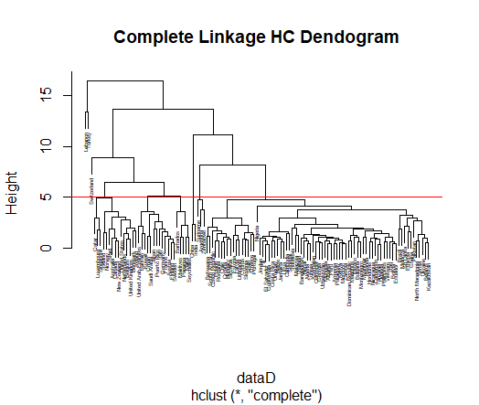
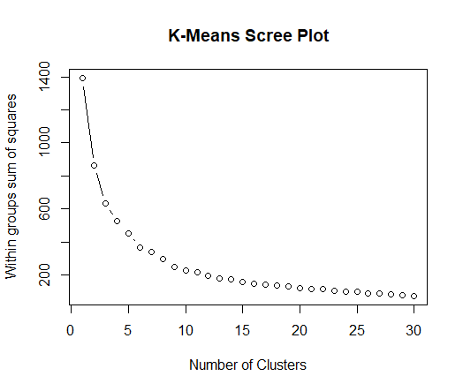
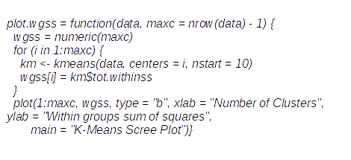

Slide 23
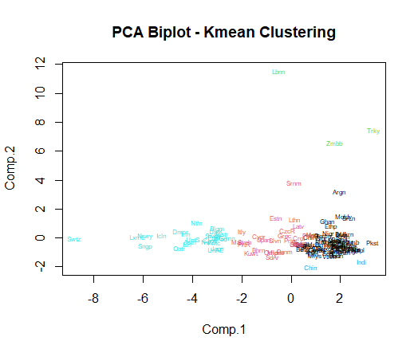









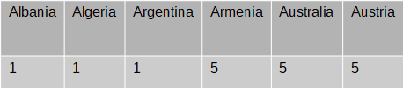
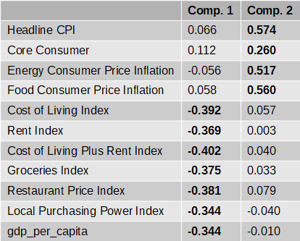
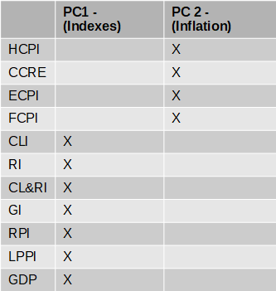

Slide 24
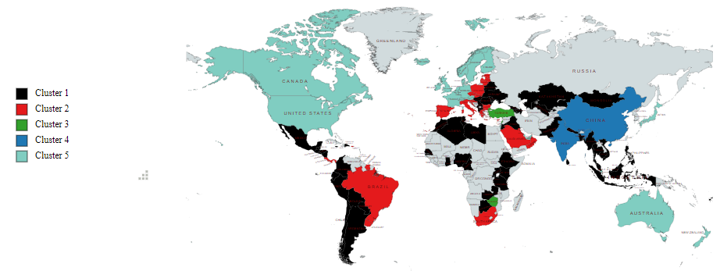


Slide 25
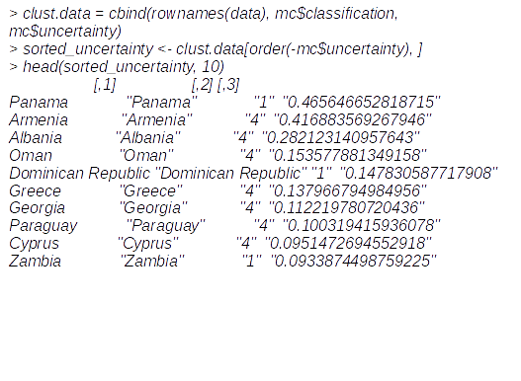
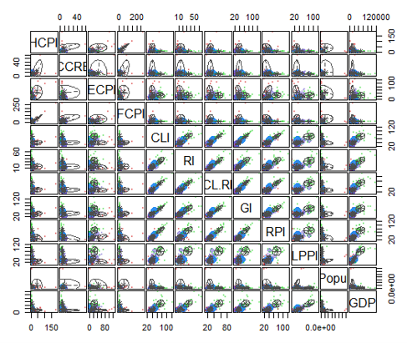
plot(mc, what = "uncertainty")
Pearson's Chi-squared test
Contingency Table
chisq.test(tb)
KM & HC R^2 = 468
Model R^2 = 351

Slide 26
CONFIRMATORY FACTOR ANALYSIS

Slide 27
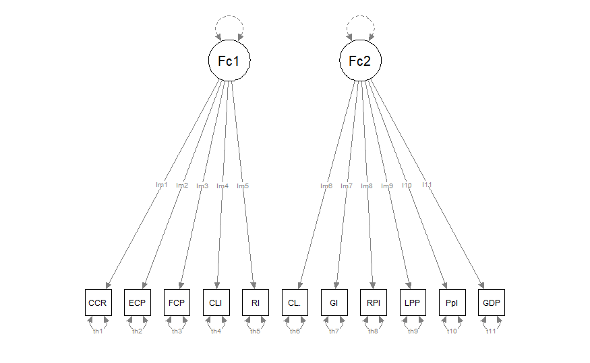
CFA Model & Results
Factor 1 – Core Inflation
Consumer & Economic Confidence
Factor 2 – Broader Economic
Global/Comprehensive Impact
Notes:
In this area, we had difficulty with CFA meaning that the data was not suitable for the process. We ran into issues in the results for the model which will be discussed in detail in the report. We were still able to create this diagram which shows how our data aligns with the identified factors, And this diagram shows the division of the data, so we can see the relationships visually.
The results suggest that the global inflation data can be summarized by two latent factors. Factor 1, labeled "Core Inflation," is strongly associated with variables reflecting consumer and economic confidence, such as HCPI, CCPI, and FCPI. Factor 2, labeled "Broader Economic," is associated with indicators that have a more global and comprehensive economic impact, such as ECPI and LPPI. These factors provide a simplified representation of the underlying structure of the data, making it easier to interpret and analyze the key drivers of inflation.
We tried changing the model, playing around with the variables, etc.

Slide 28
EFA & Interpretation
Factor 1: Core Inflation
Headline Consumer Price Index (HCPI) has a high loading of 0.862
Core Consumer Price Inflation (CCPI) has a high loading of 0.731
Food Consumer Price Inflation (FCPI) has a high loading of 0.846
Factor 2: Broader Economic
Local Purchasing Power Index (LPPI) has a loading of 0.503
Restaurant Pricing Index (RPI) has a loading of 0.681
Notes:
First, we perform an exploratory factor analysis (EFA) for finding two latent variables. Then we use those variable for doing CFA
We started with an exploratory factor analysis (EFA) to identify two key factors. Factor 1 to captures a latent construct related to core inflation. The variables with high loadings are indicators that typically reflect the sentiment and confidence of consumers and economic participants. Higher scores on Factor 1 could be associated with periods of stable and predictable inflation driven by consumer and economic confidence. Factor 2 represents a broader economic factor. The variables with high loadings suggest that this factor is associated with indicators that have a more global or overarching economic impact. LPPI and RPI also contributes to the broader economic context. Higher scores on Factor 2 could be indicative of economic conditions that extend beyond domestic consumer factors.
The two factors we identified in the exploratory factor analysis (EFA) account for a significant portion of the data, explaining around 56.5% of the total variance. This means we've captured the essence of our variables quite effectively.

Slide 29
CONCLUSION

Slide 30
Overall, the inflation dynamics in 2022 (post-covid) appear to follow an unconventional route than we’ve seen in the past years. Even though many factors are influenced by inflation, it appears that after covid, standard of living and consumer expenses remained affordable.

